Slide 1

Branch - CSE Python Programming
Lecture – 23 Sets – Part 2
By
Dr. Smita Tiwari
Assistant Professor
Department of Computer Science and Engineering
School of Engineering & Technology

Slide 2
Python Set Operations
Set Union
Set Intersection
Set Difference
Set Symmetric Difference

Slide 3
Set Union
Definition and Usage
The union() method returns a set that contains all items from the original set, and all items from the specified set(s).
You can specify as many sets you want, separated by commas.
It does not have to be a set, it can be any iterable object.
If an item is present in more than one set, the result will contain only one appearance of this item.

Slide 4
Set Union
Syntax
Parameter Values
Parameter | Description
set1 | Required. The iterable to unify with
set2 | Optional. The other iterable to unify with. You can compare as many iterables as you like. Separate each iterable with a comma

Slide 5
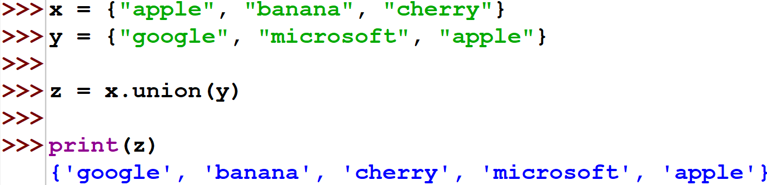
Set Union - Examples

Slide 6
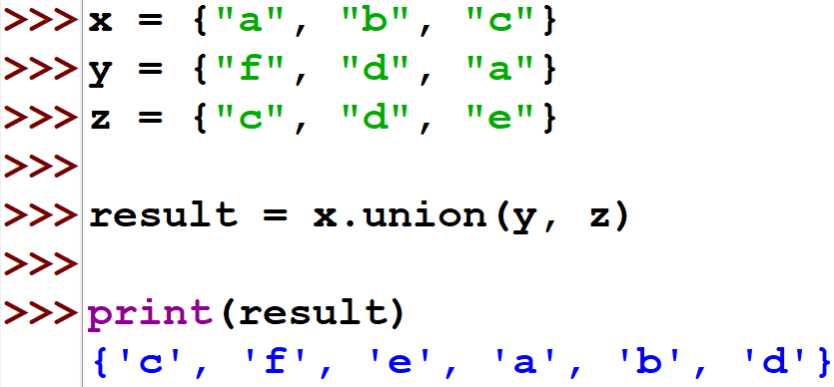
Set Union - Examples

Slide 7
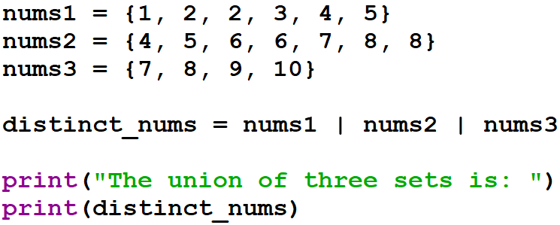

Set Union - Examples
The | operator can also be used to perform the union operation.
Output:

Slide 8
Set Intersection
Definition and Usage
The intersection() method returns a set that contains the similarity between two or more sets.
Meaning: The returned set contains only items that exist in both sets, or in all sets if the comparison is done with more than two sets.

Slide 9
Set Intersection
Syntax
Parameter Values
Parameter | Description
set1 | Required. The set to search for equal items in.
set2 | Optional. The other set to search for equal items in. You can compare as many sets you like. Separate the sets with a comma.

Slide 10
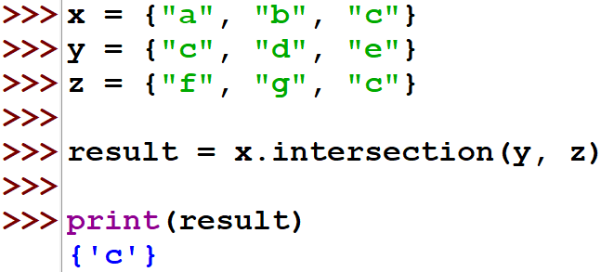
Set Intersection - Examples

Slide 11
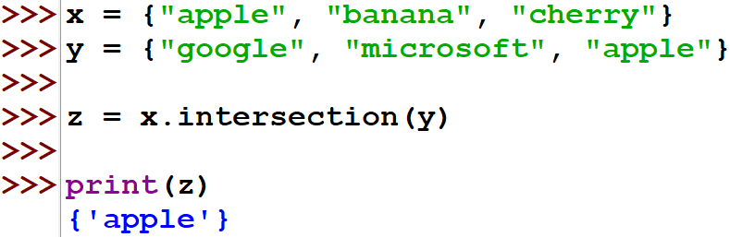
Set Intersection - Examples

Slide 12
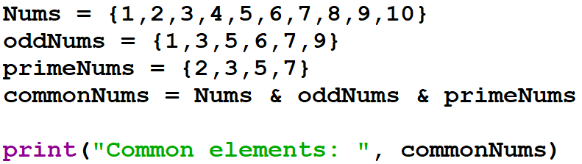
Set Intersection - Examples
The & operator can also be used to find the intersection of sets.
Output:

Slide 13
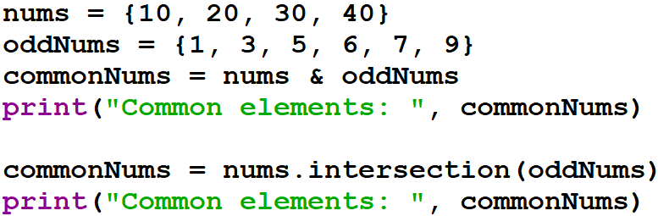

Set Intersection - Examples
It returns an empty set if no common elements are found.
Output:

Slide 14
Set Difference
Definition and Usage
The difference() method returns a set that contains the difference between two sets.
Meaning: The returned set contains items that exist only in the first set, and not in both sets.

Slide 15
Set Difference
Syntax
Parameter Values
Parameter | Description
set | Required. The set to check for differences in.

Slide 16
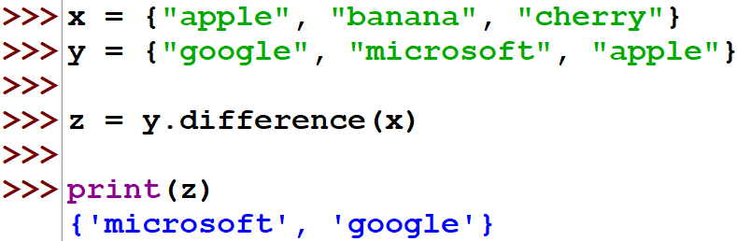
Set Difference - Examples

Slide 17
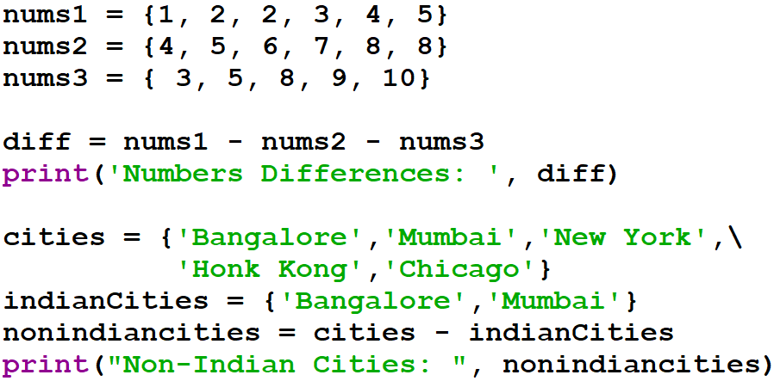
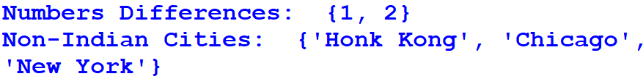
Set Intersection - Examples
The ‘-’ operator can also be used to find the intersection of sets.
Output:

Slide 18
Set Symmetric Difference
Definition and Usage
The symmetric_difference() method returns a set that contains all items from both set, but not the items that are present in both sets.
Meaning: The returned set contains a mix of items that are not present in both sets.

Slide 19
Set Symmetric Difference
Syntax
Parameter Values
Parameter | Description
set | Required. The set to check for matches in.

Slide 20
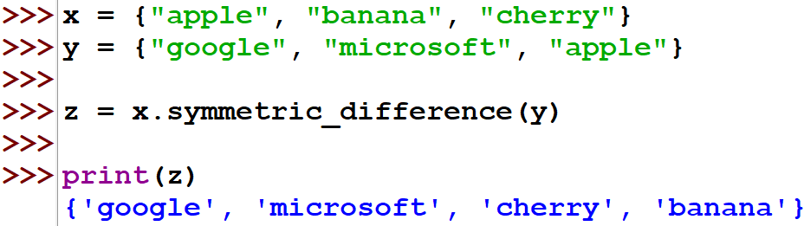
Set Symmetric Difference - Examples

Slide 21
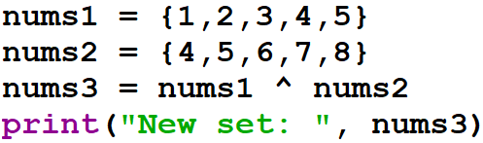
Set Symmetric Difference - Examples
The ^ operator can also be used to find the symmetric difference of sets.
Output:

Slide 22
THANK YOU

